Slide 1
Go Oslo Meetup 🎅🏻
Interfacing with native code –
An intro to CGO
Andreas Dreyer Hysing

Slide 2
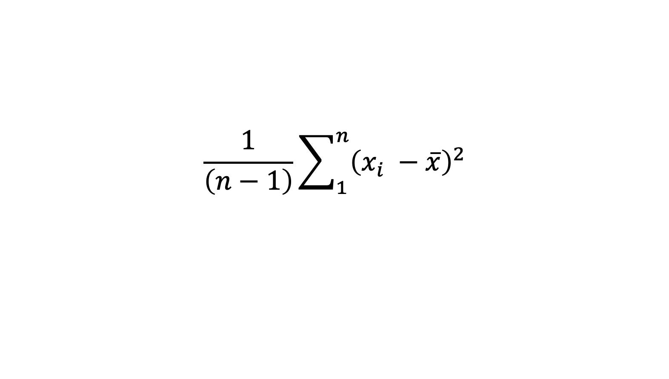
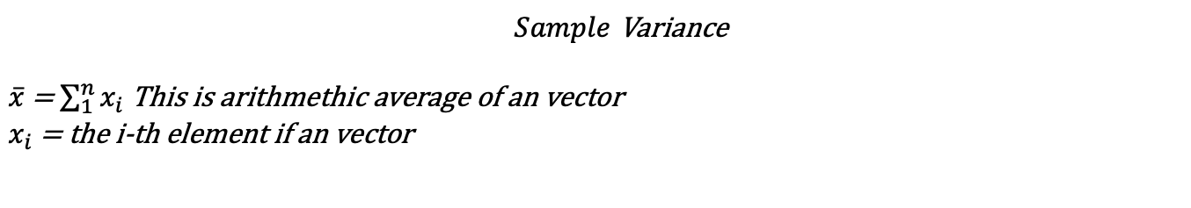
Function in Focus
Sample Variance
$$\frac{1}{\left(n−1\right)}\sum_{1}^{n}{{\left(x_{i} −\overline{x}\right)}^{2}}$$
$Sample$ Variance
$\overline{x}$= $\sum_{1}^{n}{x_{i}}$ This is arithmethic average of an vector
$x_{i}$ = the i-th element if an vector
Notes:
For more info se http://mathworld.wolfram.com/SampleVariance.html

Slide 3
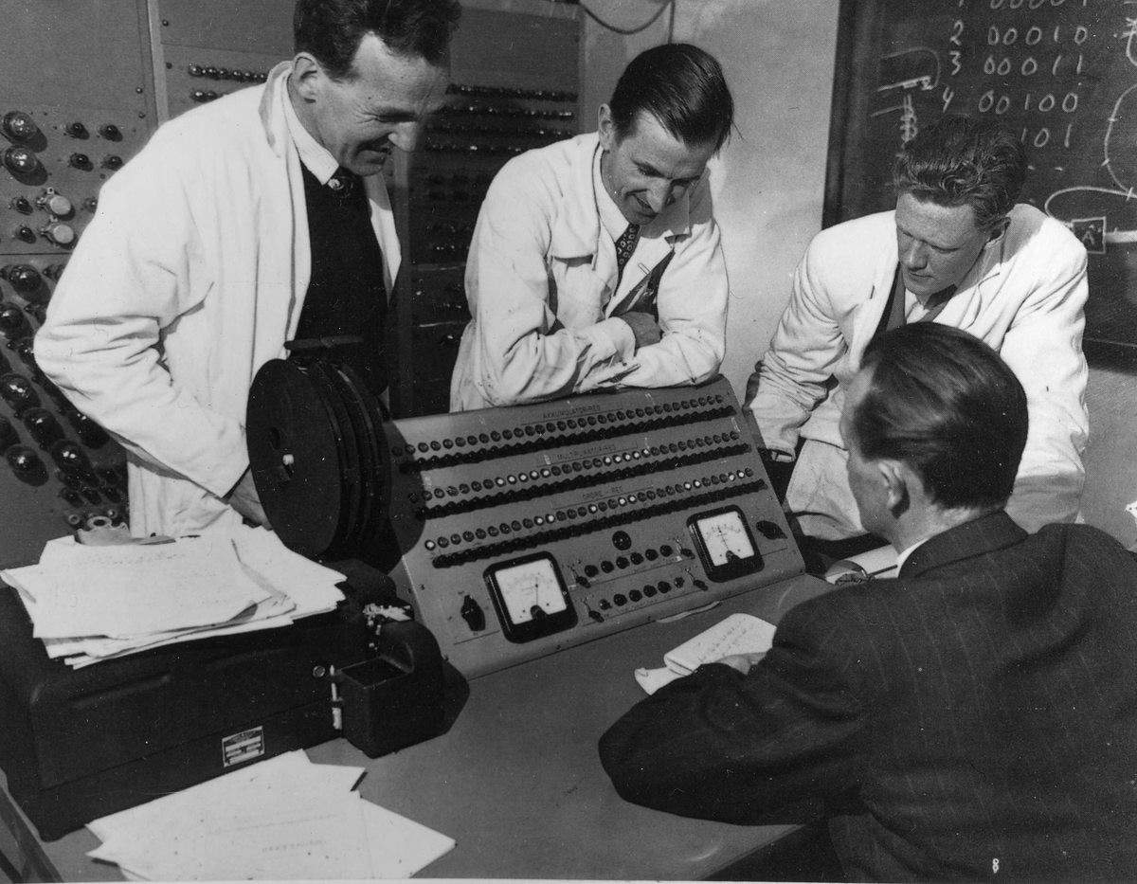
Why should I write C and C++ today?
Notes:
Just like some men has a passion for cars I have a personal passion for fast computing. I come from family with many engineers which shares my passion for computers. On the right you can se Norway’s first computer NUSSE, which was built by my fathers uncle Thomas and his team.

Slide 4
CGO
Go ships with support for c and c++. Source code in these languages can be embedded in comments inside go source files or as a separate files next to the go code.
This little known feature has provided golang with support for native system code since the start.
Go files with import «C» are entry points for c. When these impor statement is seen the go-compiler will call the c and c++ compiler for that system. On MacOS and Linux this is clang while on windows CGO assumes microsoft GCC compiler is installed.
Working with CGO
Write your code c or c++. Test and run ☺
Every c++ compiler works in two steps; first compile source to object files. Then link the object files.
Control the compiler from comments in the top of your go source files.
// #cgo CFLAGS: -O3
// #cgo LDFLAGS: -Framework Accelerate
Use environment variable CGO_ENABLED=1 to toggle c and c++ of during compilaiton.
go build –x –work to se what the compiler does

Slide 5
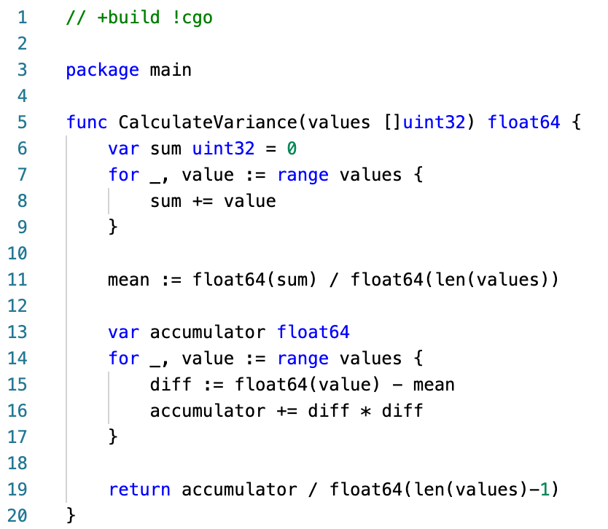

Slide 6
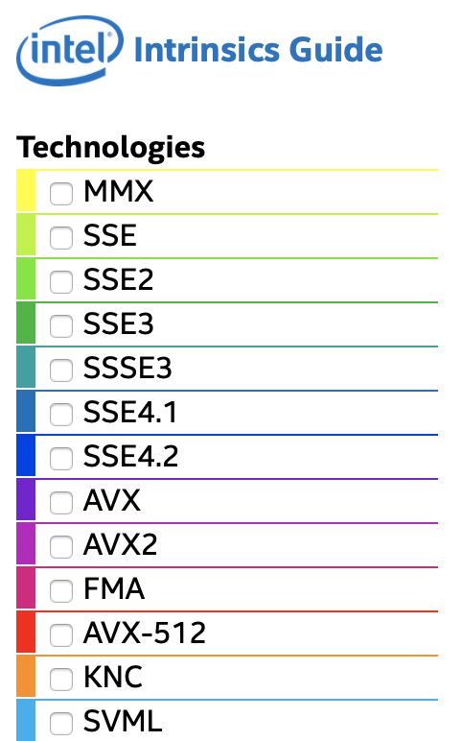

First attempt
Block Algorithm Variance
Notes:
First of we are going to use two set of techniques. When you compile with clang or download a program from the internet the developer did what he could to make a portable, reliable program rather than a fast program. What we are loosing along the way is SIMD instructions. SIMD, or Single Instructions Multiple Data, are assembly operations in your CPU which does the same operation on 4 and 4 operations at a time or 8 and 8 operations.
We want to utilize SIMD operations, but we don’t want to write assembly. Luckily for us clang, gcc and microsfts compilers can generate SIMD assembly if we turn on the correct compiler flags.

Slide 7
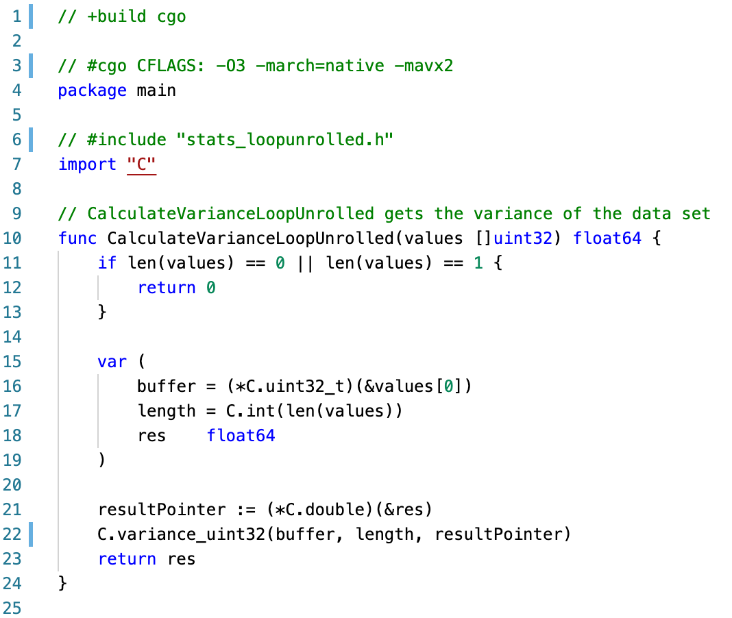
Block Algorithm Variance
Notes:
First we have to write a go function to enter he c-code which comes later.
First of we have comment containing +build cgo. This tells the compiler to only compile if CGO is enabled.
#cgo CFLAGS tells clang that I want to run with –O3 –march=native –mavx2
Then comes a lot of new types we don’t have in go; *C.double and C.int are c and c++ types entering into golang so we can cast to them before entering the c function.

Slide 8
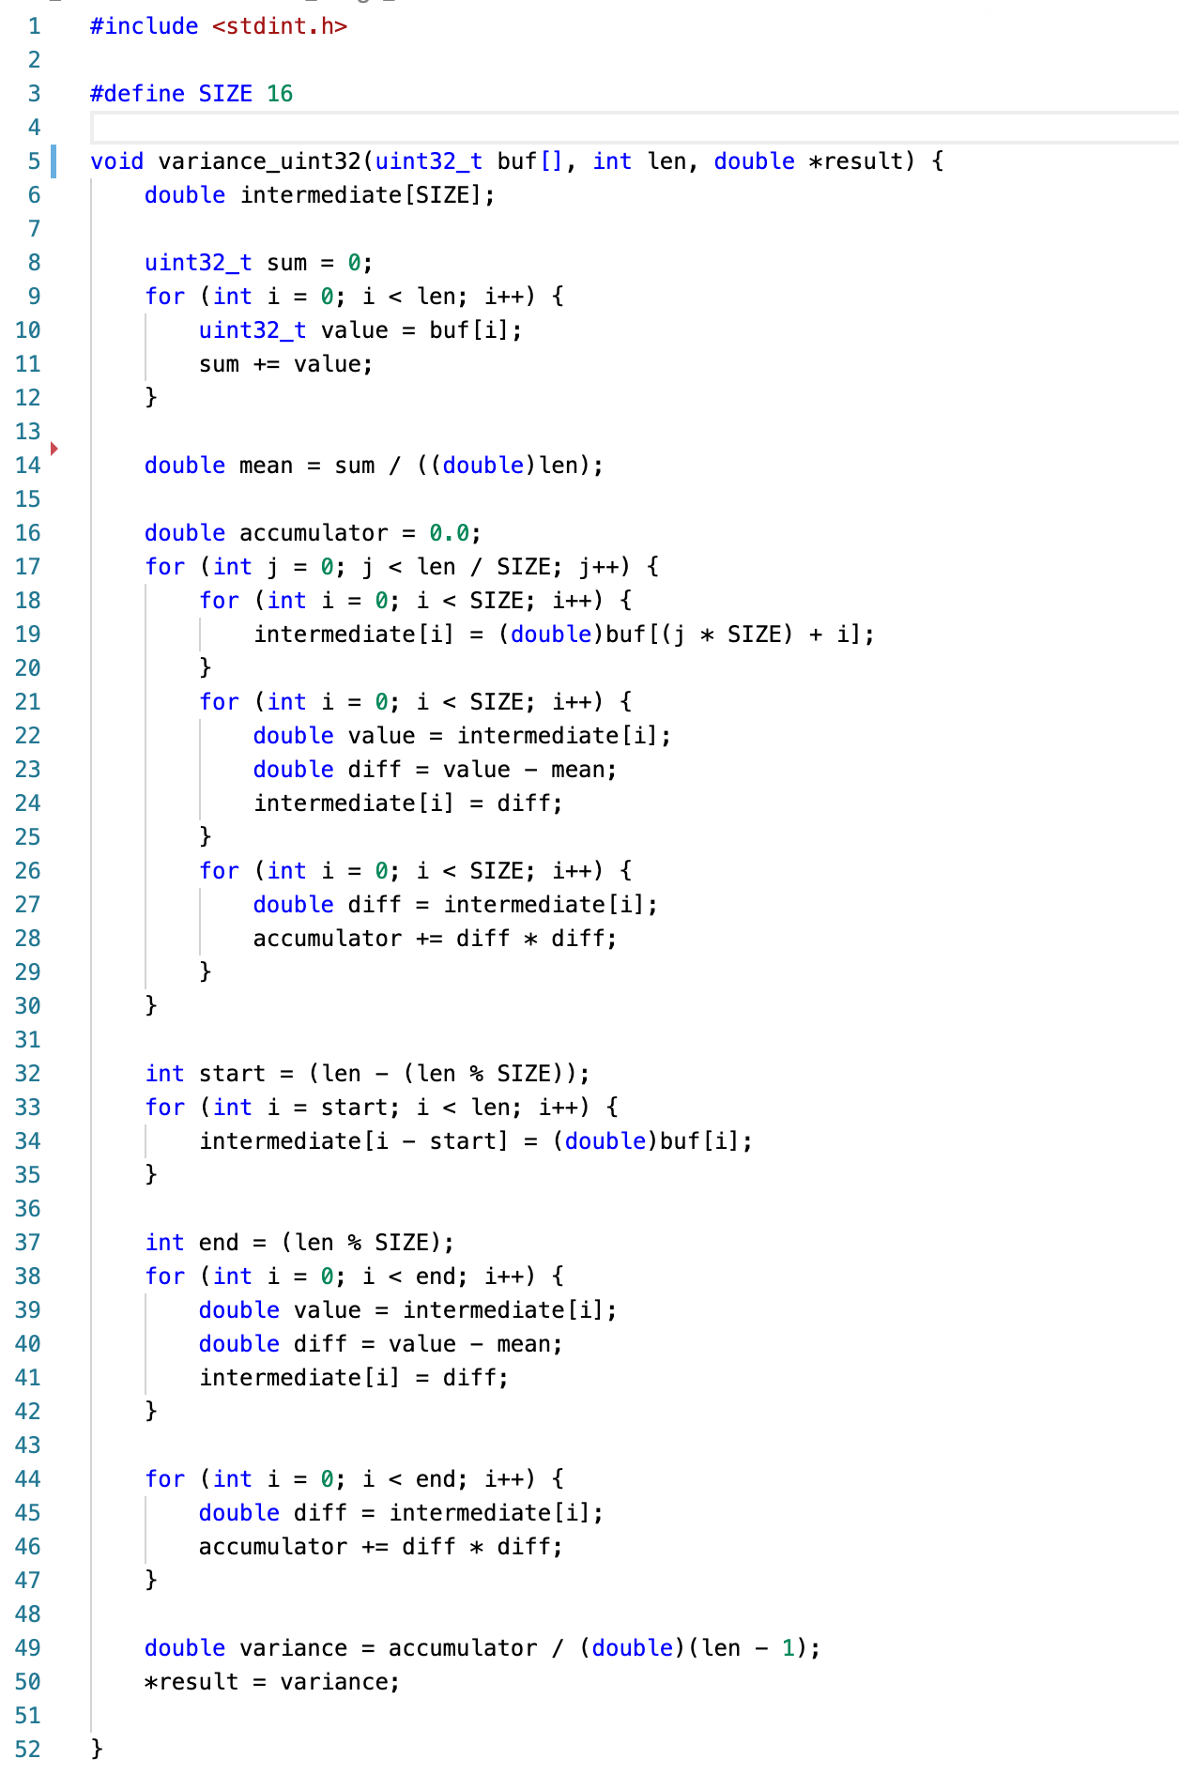
Notes:
Line 8 to 14 calculates an aritmethic average.
In the outer loop we work on 16 values at a time. That way we get the values to stay in CPU regsters and L1 cache as much as possible.
We cast to 64 bit floating points and copy 16 values into an array called intermediate. This helps for caching.

Slide 9
Notes:
If the size of the array is not a multiple of 16 we have to handle he last remaning values.
In the end we divide by the length of the array minus one.
We return the result via output variable result at line 50.
The 16 bit intermediate array makes few CPU cache misses. We are working on the same 16 values over and over between line 19 and 28.
By aligning the array size to 16 it becomes the compiler knows the loop will fit into groups of SIMD instructions with 8 values.
It is also easy for the compiler to roll out these loops without if and for statetments.

Slide 10
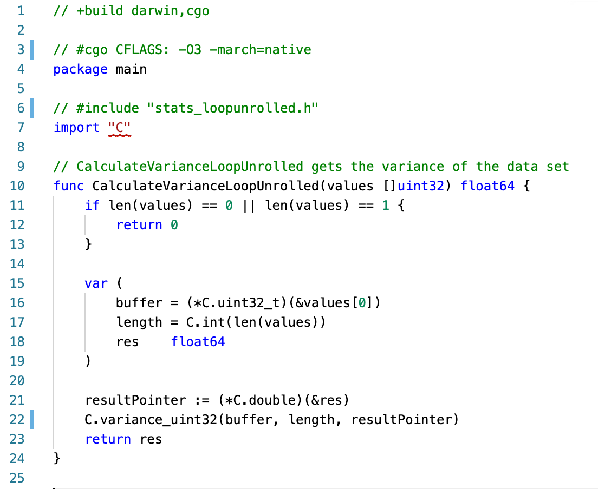
optimized L1 cache

Slide 11

Second attempt
Can we do better?
Me playing with C

Slide 12
Second attempt
You have no clue what you are doing.
Can we do better?
We can use performance libraries.
Apple Accelerate
Framework is such a framework
Me playing with C

Slide 13
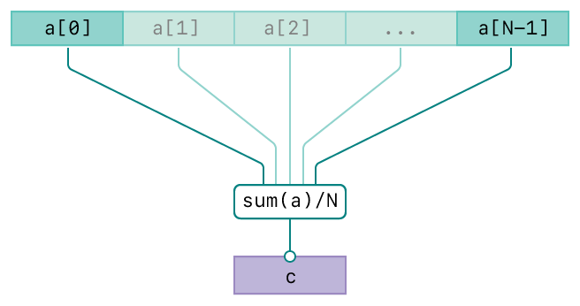
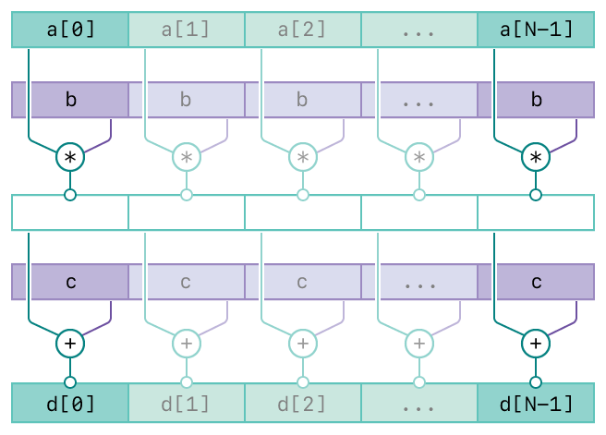
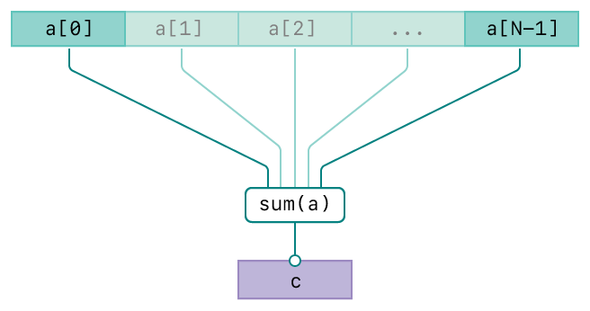
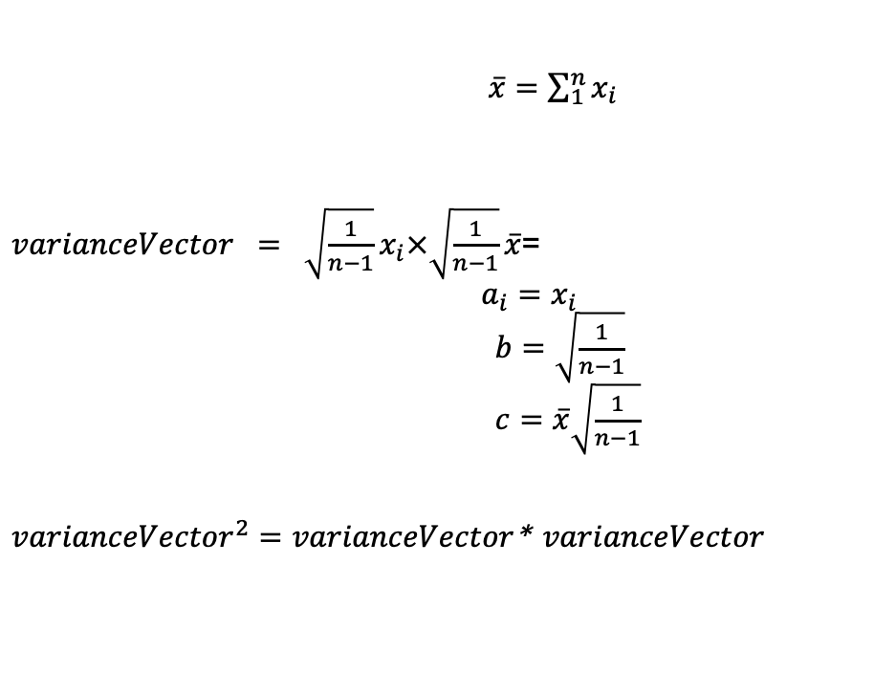
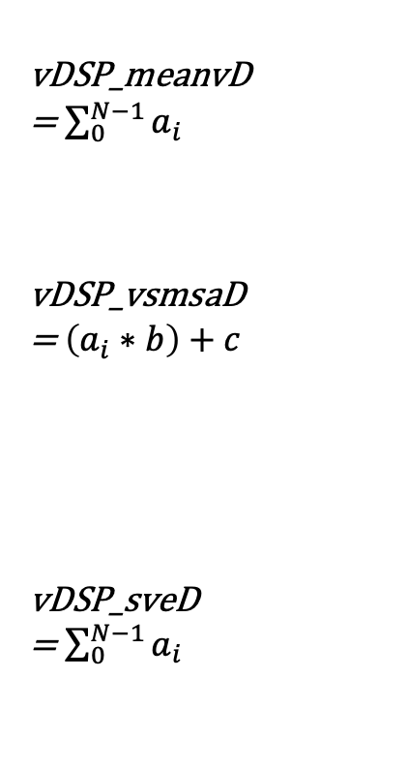
Apple Accelerate Framework
vDSP_meanvD
= $\sum_{0}^{N−1}{a_{i}}$
vDSP_vsmsaD
= $\left(a_{i}∗b\right)+c$
vDSP_sveD
= $\sum_{0}^{N−1}{a_{i}}$
$\overline{x}=\sum_{1}^{n}{x_{i}}$
$varianceVector = \sqrt{\frac{1}{n−1}}x_{i}×\sqrt{\frac{1}{n−1}}\overline{x}$=
$a_{i}=x_{i}$
$b=\sqrt{\frac{1}{n−1}}$
$c=\overline{x}\sqrt{\frac{1}{n−1}}$
${varianceVector}^{2}=varianceVector$*$varianceVector$
Notes:
To get great performance with accelerate framework we hand the responsability of blocking and loop unrolling to Apple.
First we use vDSP_meanvD to get the arithmetic mean. we trust apple that they are doing it fast and good.
Then we calculate b and c and perform vDSP_vsmsaD to peform a mused multiply add-
The Square part is not something Accelerate can help us with. We have to loop over the values.
In the end we use vDSP_sveD to sum the vector
vDSP_fltu32D : https://developer.apple.com/documentation/accelerate/1449794-vdsp_vfltu32d?language=occ
vDSP_meanvD : https://developer.apple.com/documentation/accelerate/1449784-vdsp_meanvd?language=occ
vDSP_vsmsaD : https://developer.apple.com/documentation/accelerate/1450432-vdsp_vsmsad?language=occ
vDSP_sveD : https://developer.apple.com/documentation/accelerate/1450567-vdsp_sved?language=occ

Slide 14
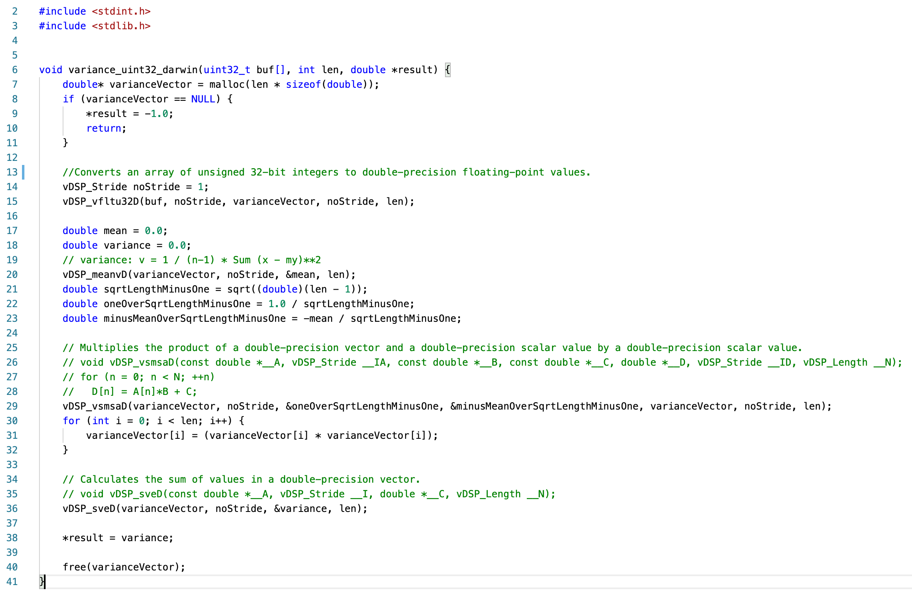
Notes:
All the functions starting with vDSP are part of Accelerate framework. These functions are part of a module called vDSP, and are ment for digital signal processing. The clever engineers at Apple has put tremendous effort into making this code fast and repliable across Apple TV, Apple Watch, iOS and MacOS.

Slide 15
Notes:
I ran the numbers on three different macOS machines; one iMac 2011, one macbook pro 2014 and one macbook pro 2018. I know tthe numbers can be a bit hard to read but bear with me.
Smaller is better.
* To the right we have the running time of calculating variance for 4096 values. Accelerate on the newest mac dominates the game with only 200 milliseconds for the whole run. Ompressive work by the apple engineers.
The turquoise and blue lines are the same Accelerate framework function on different machines. The rightmost turquoise is the 8 year old iMac. It performs almost three times as bad as the new macbook pro with 683 milliseconds. Not so strange since the iMac lacks support for Intel AVX2 assembly we use.
The oranger and white are the blocking hand-optimised c algorithm. It performs better than go, but it is a big suprise that my for year old MacBook Pro performed better than the new macbook pro. I guess chaching strategies inside the two different processor has a lot to say.
Native go code is the slowest on all the computers.

Slide 16
Notes:
This is even more interesting. Here we see performance on 64 and 512 floating point values.
When we look closer on the lower vector sizes the tables have turned. For 64 values in the array or vector the go code is consistently faster than the c and c++ code on he same machine.
In fact experiments with different vector sices shows that the variance hitts break even at 256 values in the array. Before 256 values go code is allways faster than C and C++.

Slide 17
Should I write variance in C or C++
If you have more than 256 rows in excel
👨‍🏫

Slide 18
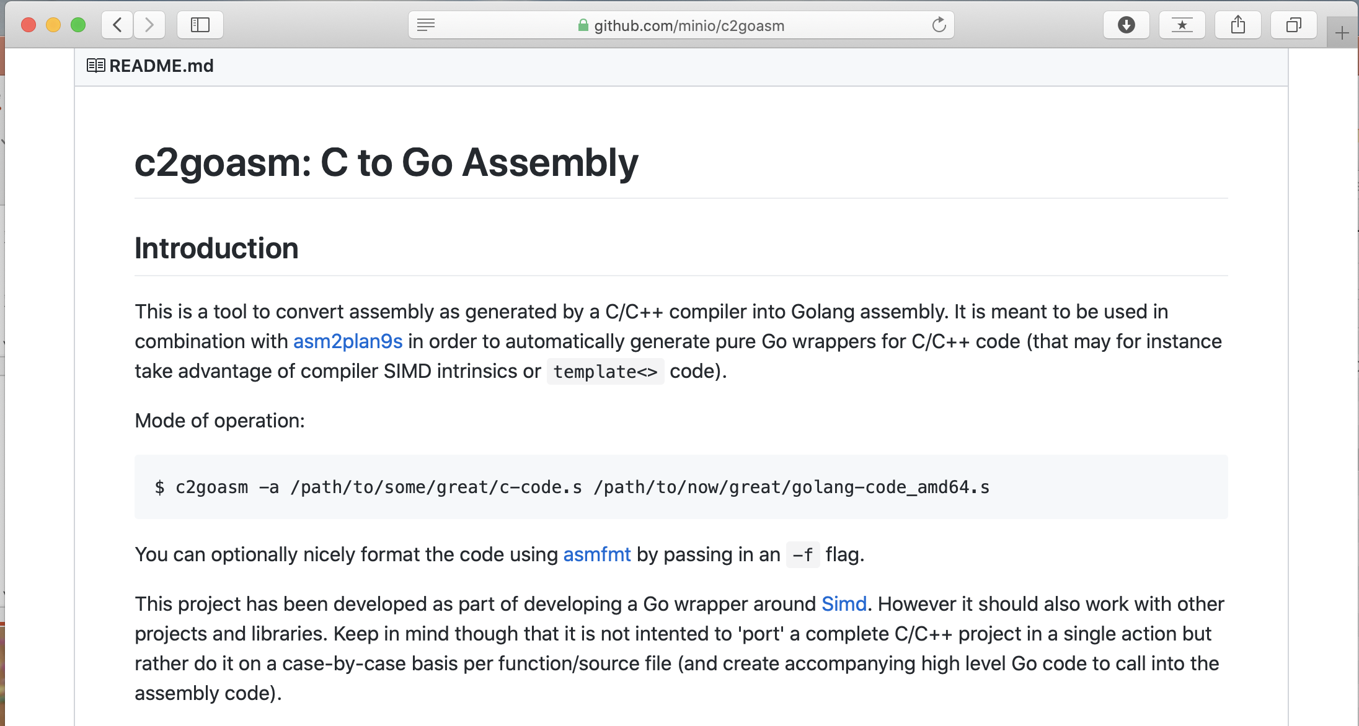
Honorable Mention to github.com/minio/c2goasm
Notes:
I read up on why CGO is performing so bad and there seems to be due to the Foreign Function Interface (FFI) go is applying. Basicly go takes a lot of precautions before entering c-and. It saves all values to a stack before running any c call. This takes a lot of time, but prevents data corruption.
A company called min.io has tried to tackle that, and created the project c2goasm. This project takes LLVM and clang assembly and glues it directly into the go compiler dropping the Foreign function interface all together. I think this is interesting, but after wasting weekend not getting it to compile without crashes I am ready to conclude that c2goasm is an experiment at best. Don’t waste your time on it right now.

Slide 19

What have we learned?
C and C++ is intefrates well with go and the go compiler. The extra steps of compiling c and c++ is easily configured with build and compile flags in CGO. No extra tools required.
Calling C and C++ works wel, and bridges the gap to legacy applications and libraries written in these languages.
The overhead of calling C and C++ is significant. It will shadow the potential peformance benefit.
Writing C and C++ is time consuming as allways.
... and it is ingredibly exciting.
Happy coding with CGO

Slide 20

See my github page to learn more about
my experiment
https://github.com/ahysing/fast-variance

